Slide 1


HP World/Interex 2002
Linux System
Administration Basics
Chris Cooper
(734) 805-2172 chris_cooper@hp.com
George Vish II
(404) 648-6403 george_vish@hp.com

Slide 2
User
Login
Version A.00
U2794S Module 5 Slides

Slide 3

Next Step — Logon
Now that you have your system installed and running it’s time to get to work.
The Linux “user” environment and basic system security are based on users having unique logon identities and passwords.
Linux users are also associated with one or more “group” identities for the sake of access control.
Later we will discuss setting up user accounts in full detail. For now, let us simply examine some of the options available for user login control.

Slide 4
GNOME Login
The GNOME , GNU Network Object Model Environment, project has built an easy-to-use desktop environment for the user.
The GNOME development platform is a rich collection of tools, libraries, and components to develop application on UNIX/Linux
GNOME Office is a set of office productivity applications
GNOME login provides for customization of login options.
GNOME makes use of the X Window System protocols and allows for each user account to customize it’s appearance and features
For additional information -> http://www.gnome.org

Slide 5
KDE Login
KDE, the K Desktop Environment, is a network transparent contemporary desktop environment for UNIX/Linux workstations.
KDE seeks to fill the need for an easy to use desktop for UNIX/Linux workstations, similar to the desktop environments found under the MacOS and MS-Window offerings.
KDE offers an application development framework with a considerable number of applications already built for use with the K Desktop Environment
KDE login provides for customization of login options.
KDE is a graphical environment that uses X Window System protocols. Each user is allowed extensive control over look and feel of their individual session environment.
For additional information -> http://www.kde.org

Slide 6
The “Virtual” Consoles
This feature of the Linux user environment allows the system console to support multiple logon sessions.
F4
F3
F5
GUI
F7
F2
F6
F1
To switch from one “virtual” console screen to another, press and hold Alt+Ctrl+Fn (F1 through F7, depending on which session you want to view). Console 7 is always the GUI, while Consoles 1–6 are provide command line virtual terminal interfaces.

Slide 7
Rebooting into Single-User Mode
The system can be booted into single-user mode from the LILO prompt --> LILO: linux single
The system can be booted into single-user mode even if there are no /etc/passwd and /etc/shadow files
Be aware! Anyone can boot the system to single-user mode!
The newer boot loader, GRUB, avoids this issue by allowing for a boot loader password for various options (such as booting to single user mode). The actual sequence to boot single user is slightly more involved and requires the editing of the GRUB boot configuration file on-the-fly.

Slide 8
Linux
Startup and
Shutdown
Version A.00
U2794S Module 6 Slides

Slide 9

Intel (IA-32) Boot Order
System BIOS
P.O.S.T
Run Master
Boot Program
Read the
MBR
Scan first
sector of disk
Find Active
Partition
Run
boot loader
Find the
Kernel
Boot Kernel
vmlinuz
Notes:
A Typical BIOS POST Sequence
Most BIOS POST sequences occur along four stages (five if you have a
PCI bus):
1. Display some basic information about the video card like its brand, video
BIOS version and video memory available. Since the system's BIOS takes over
the POST right after the video card BIOS, you will not have enough time t
read the displayed information.
2.Display the BIOS version and copyright notice in upper middle screen.
You will see a large sequence of numbers at the bottom of the screen. This
sequence is the BIOS identification line.
3. Display memory count. You will also hear tick sounds if you have enabled
it (see Memory Test Tick Sound section).
4.If you have a PCI bus, the system will attempt an initialisation of the cards
and will display the card's name.
5.Once the POST have succeeded and the BIOS is ready to call the
operating system (DOS,OS/2, NT, WIN95, etc.) you will see a basic table of th
system's configuraions:

Slide 10
System Boot, “Waking the Linux Kernel”
Basic input/output system (BIOS)
Linux loader (LILO, Grub, ...)
Kernel (/boot/vmlinuz or /vmlinuz)
Dual boot system
  Power on
  LILO: (GUI) up/down arrow to desired label <Enter>
  (TUI) boot OS-Name [Enter]
  Grub: (GUI) Select desired O/S image from the list

Slide 11
Linux’s First Process—init
The init process
/etc/inittab
vmlinuz
id:5:initdefault
si: :sysinit:/etc/rc.d/rc.sysinit
Run levels:
0, 1, 2, 3, 5, 6, s, S

Slide 12
The rc Script Model
Linux distributions follow a couple different “rc” script models.
  Some use the older BSD “rc” model (ie. SuSE)
  RedHat follows a modified SysV model
For the SysV model execution scripts are most commonly stored in:
  /etc/rc.d/init.d
Link scripts are stored in either /etc/rc.d/rcN.d or /etc/rcN.d
  Run states are independent and not hierarchical ! (this is a fundamental difference between Linux and most UNIX variants, be careful !)
Start and Kill scripts use a two digit sequencing number in their naming convention. (ie. S20Sendmail and K80Sendmail)
To store configuration information look in the following directories (and sub-directories):
  For SuSE : /etc/rc.config file
  For Red Hat : /etc/sysconfig directory

Slide 13
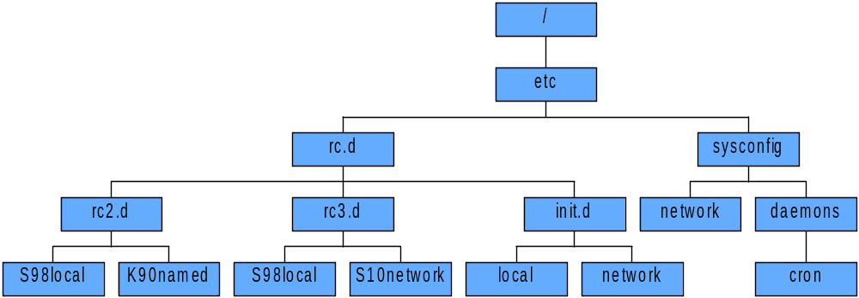


rc Script Locations
Some available management utilities:
chkconfig command line utility
ntsysv a TUI utility
-> System Settings -> Service Configuration
-> System -> SysV-Init Editor

Slide 14
System Shutdown Commands
Syntax: shutdown[-tkrhfFc] time|now
Shutdown to single-user:
  # shutdown
  # init 1
Reboot:
  # shutdown -r time
  # reboot
  # init 6
Halt:
  # shutdown -h time
  # reboot -h
  # init 0
Restart your X-session
Ctrl
+
Alt
+
Del

Slide 15
System Administration Tools and
Techniques
Version A.00
U2794S Module 7 Slides

Slide 16

Sources of Information
Online documentation
  FAQs and HOWTOs
Internet resources (license required for access to some areas)
  http://sunsite.unc.edu
  http://www.redhat.com
  http://slashdot.org (Linux news)
  http://freshmeat.net (Linux downloads)
  http://linuxv2.com (kernel development)
  http://metalab.unc.edu/pub/Linux (MetaLab archives over 55 gigabytes of Linux programs and documentation, freely available for download via FTP and WWW access)
  http://www.hp.com/go/linux
  HP support line
Internet newsgroups (comp.os.linux.*); for example,
    comp.os.linux.networking
    comp.os.linux.security
    comp.os.linux.admin
    comp.os.linux.setup
    comp.os.linux.hardware
An astounding number of books

Slide 17
Linux Documentation Project
Standard (and totally free) documentation suite for Linux:
  (many mirrored sites)
http://www.linuxdoc.org/

Slide 18
Configuration Files and the System Administrator
The Linux operating system’s configuration is controlled by a
host of ASCII text files accessible to the administrator (root),
for editing manually, or through one of the many GUI and TUI
utilities available to the root user.
/etc/passwd
/etc/group
/etc/hosts
/etc/services
etc...

Slide 19
/etc/passwd and /etc/group
The file /etc/passwd contains the basic user configuration parameters.
root:1e2wsFt563w6x:0:0:,,,:/root:/bin/sh
user:3he5Ty67sd32d!:101:20:,,,:/home/user:/bin/sh
<user name>:<encrypted password>:UID:GID:comments:HOME:SHELL
The file /etc/group contains the basic group configuration parameters.
Bin::0:root
users::20:user,user2,user3,………..
<group name>:<encrypted password>:GID:<members> (comma delimited)

Slide 20
Creating User Accounts
Command line
  # useradd username and groupadd groupname
  # passwd username
KDE desktop:
  Click on the K -> System -> User Manager
GNOME desktop:
  Click on Start Here -> System Settings -> User Manager
Some distributions have their own graphical tools:
  For SuSE: yast (yet another startup tool):
  # yast -> System administration -> User administration
  For Red Hat 6.x: linuxconf
  # linuxconf -> Config -> Users -> Normal -> User Accounts

Slide 21
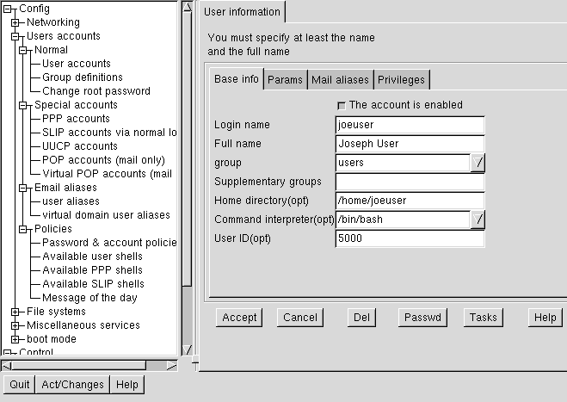
Using linuxconf

Slide 22
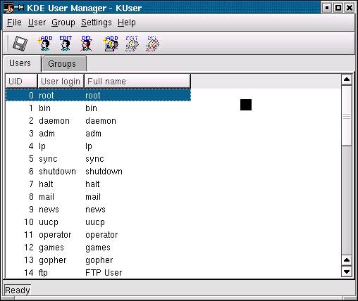
The KDE User Manager - KUser

Slide 23
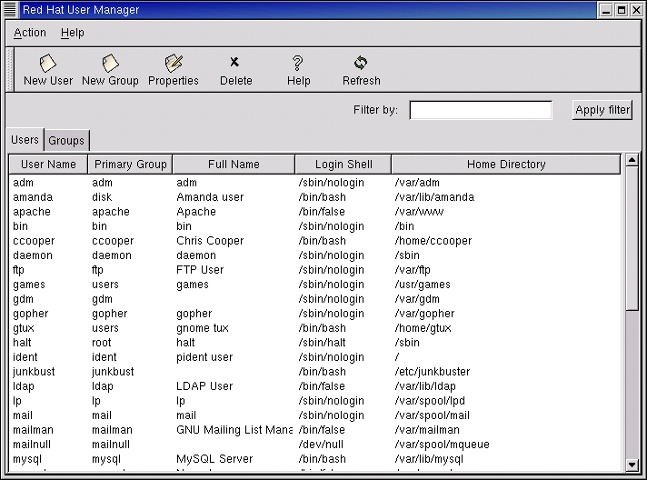
The Red Hat User Manager

Slide 24
crypt—Linux’s Front Line Security
Password encryption is based on the the crypt routine.
The routine requires a 2-character “encryption key” and performs
the encryption on the first 8 characters of the argument.
To crypt plain text passwords a process calls the kernel function (in pseudo code):
  string=crypt(“mygr8pwd”,”AZ”)
  print(string) -> AZwr.EfTdeWeI
If it were called with a longer “password.”
  sting=crypt(“mygr8pwdlonger”,”AZ”)
  print(string) -> AZwr.EfTdeWeI

Slide 25
The /etc/shadow File
The basic crypt algorithm cannot be reversed. However, because the crypt “key” is stored as the first two characters of the /etc/passwd password field, a clever hacker can employee any of a number of programs and scripts to simply “guess” your password.
One method to improve the basic security of your system is to remove the encrypted passwords from /etc/passwd, which is readable by anyone and everyone. This can be accomplished with “shadow passwords.” Once enabled, the encryption's are stored in /etc/shadow, a file that is readable only by root.
To convert from the standard passwords to “shadow passwords” enter:
  # pwconv (This can be reversed with pwunconv.)
NOTE: Shadow passwords can be used in conjunction with MD5 encryption.

Slide 26
/etc/passwd Corrupted
The system uses the /etc/passwd file first to validate login details.
On average, the /etc/passwd file is read once for every twelve file accesses.
The /etc/passwd file contains the following fields of data:
    Name:passwd:UID:GID:Text:HOME_path:Login_shell
Do not use spaces, except in the “Text” field.
Use the pwchk command to check the file syntax.

Slide 27
Shadow Passwords Corrupted
The /etc/shadow file contains user password controls.
The user’s password, in encrypted form, is stored in this file.
The fields in this file are:
    Name:Password:Last_Change:Min:Max:Warn:Inactive:
    Expiry_Date:Reserved_Field
Password entries may differ if PAM is in use on the system.

